Slide 1
MLSA Full Stack Web Development Internship Report
Name: Prabhu Prasad Das
University Roll No. 2300290100173
CSE 3_C 2023-27 batch

Slide 2

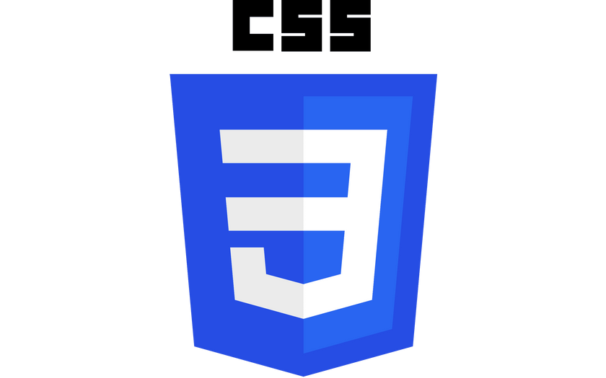

Tech Stack used
HTML (HyperText Markup Language) is the standard language for creating web pages. It uses tags to structure content.
CSS (Cascading Style Sheets) is a styling language used to define the look and layout of HTML elements on a webpage.
JavaScript is a versatile, high-level programming language primarily used to
add interactivity and dynamic
content to websites.

Slide 3
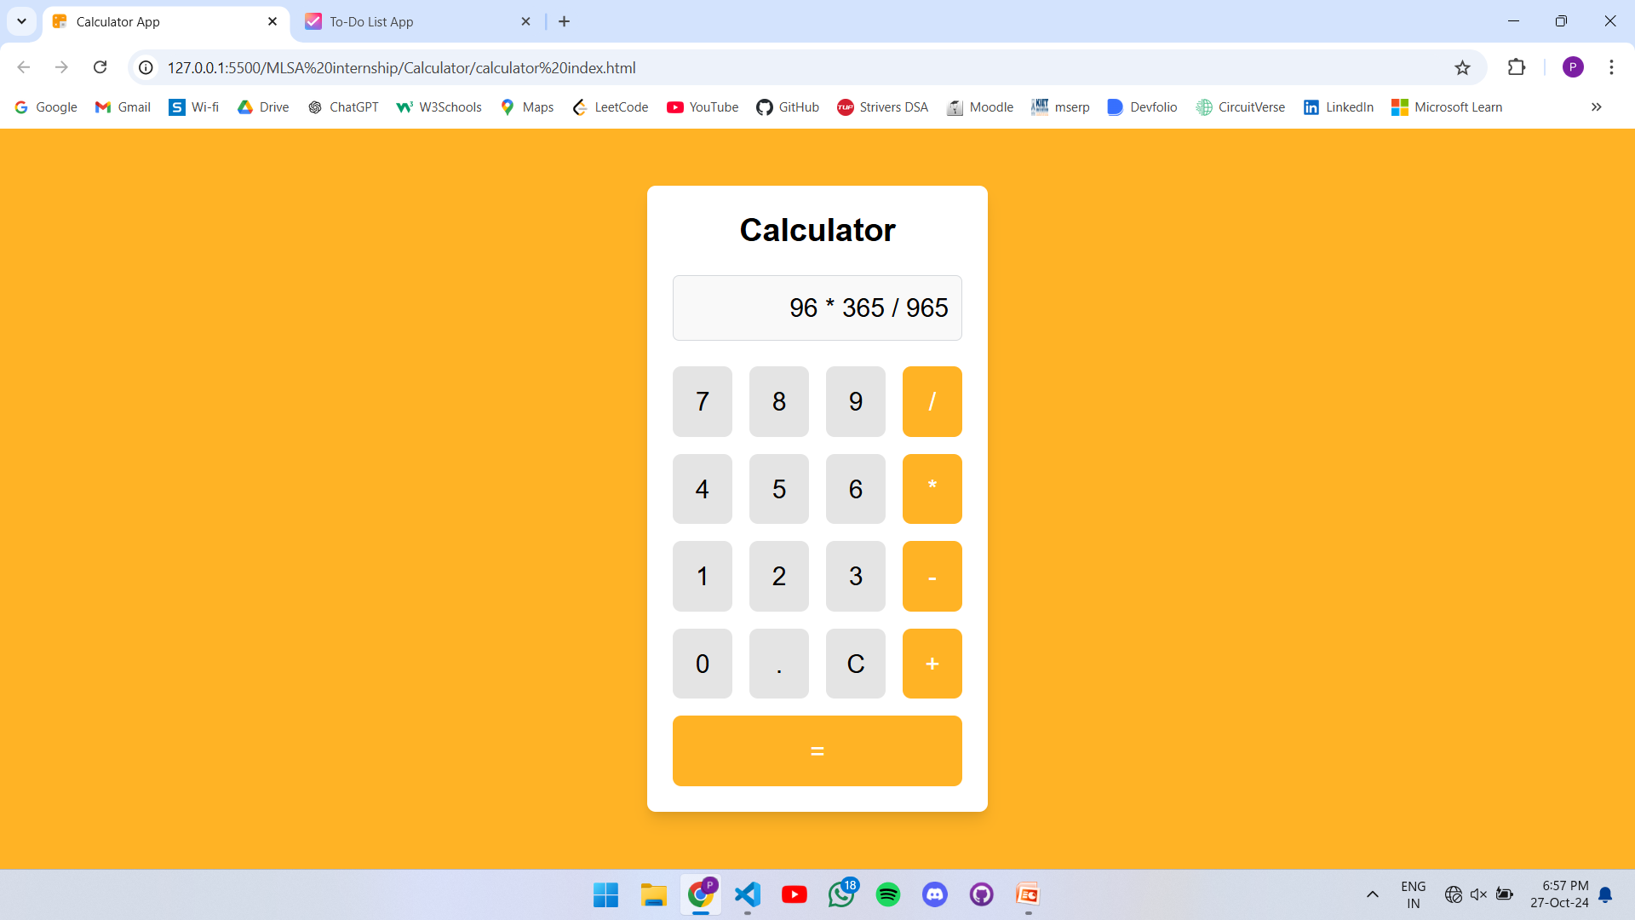
Medium Project: Simple Calculator

Slide 4
Calculator Features
Basic Arithmetic Operations: Supports addition, subtraction, multiplication, and division.
Clear/Reset Button: A button to clear the current input or reset the calculator to its default state.
Decimal Support: Allows entering and operating on decimal numbers, crucial for precision.
Backspace/Delete: A button to delete the last entered digit for correcting mistakes without clearing the entire input.
Adaptability: works well in PC and Mobile
Reliability: enables you to do easy and quick calculations

Slide 5
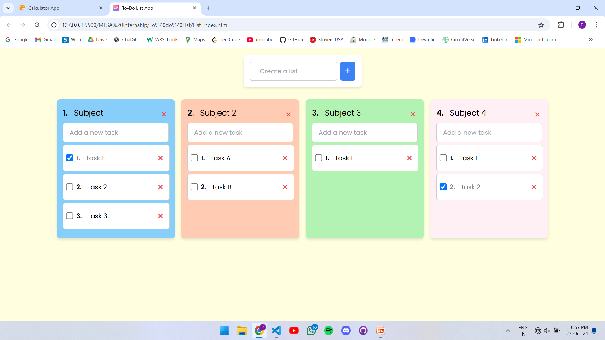
Easy Project: To-do List

Slide 6
To-Do list features
Create Multiple list: Create separate lists with separate tasks to keep track you tasks easily
Add New Task: A simple input box and button to add new tasks with minimal effort.
Mark Task as Complete: Checkbox or button to mark tasks as completed, often with a visual change, like strikethrough text.
Delete Task: A quick way to delete tasks from the list once they're completed or no longer needed.
Edit Task: Ability to modify the text of a task to update or clarify it.
Boosts productivity: Helps you stay in track of your work anytime you want to check.

